Slide 1
Class 15 - Input/Output
Osama Hosam Eldeen
Taiba University

Slide 2
I/O devices - terminology
Device (mechanical hardware)
Device controller (electrical hardware)
Device driver (software)
Notes:
Separte I/O memory space
Memory mapped i/o
Hybrid
Memory mapped takes part of memory for moving I/O around. Has nothing to do with DMA.

Slide 3

Example devices and their controllers
Monitor
Bus
Components of a simple personal computer

Slide 4
Device controllers
The Device vs. its Controller
Some duties of a device controller:
  Interface between CPU and the Device
  Start/Stop device activity
  Convert serial bit stream to a block of bytes
  Deal with errors
    Detection / Correction
  Move data to/from main memory
Some controllers may handle several (similar) devices

Slide 5
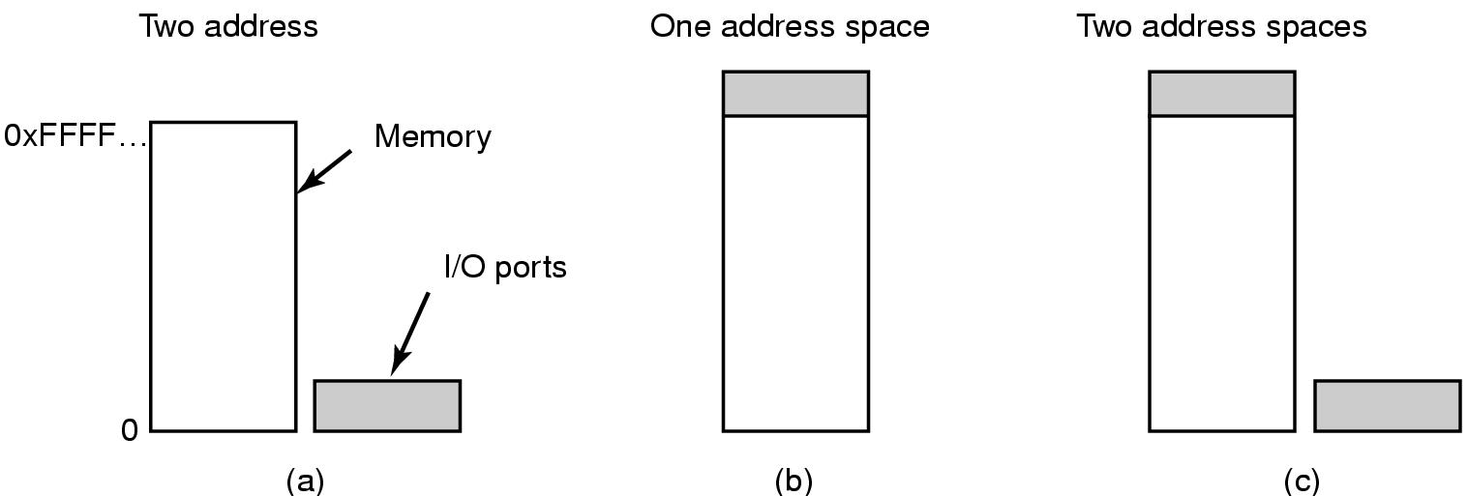
How to communicate with a device?
Hardware supports I/O ports or memory mapped I/O for accessing device controller registers and buffers

Slide 6
I/O ports
Each port has a separate number.
CPU has special I/O instructions
  in r4,3
  out 3,r4
Port numbers form an “address space”... separate from main memory
Contrast with
  load r4,3
  store 3,r4
The I/O Port Number

Slide 7
Memory-mapped I/O
One address space for
  main memory
  I/O devices
CPU has no special instructions
  load r4,addr
  store addr,r4
I/O devices are “mapped” into
  very high addresses
0x00000000
Physical
Installed
Memory
0xFFFF0000
I/O
Devices
0xFFFFFFFF

Slide 8
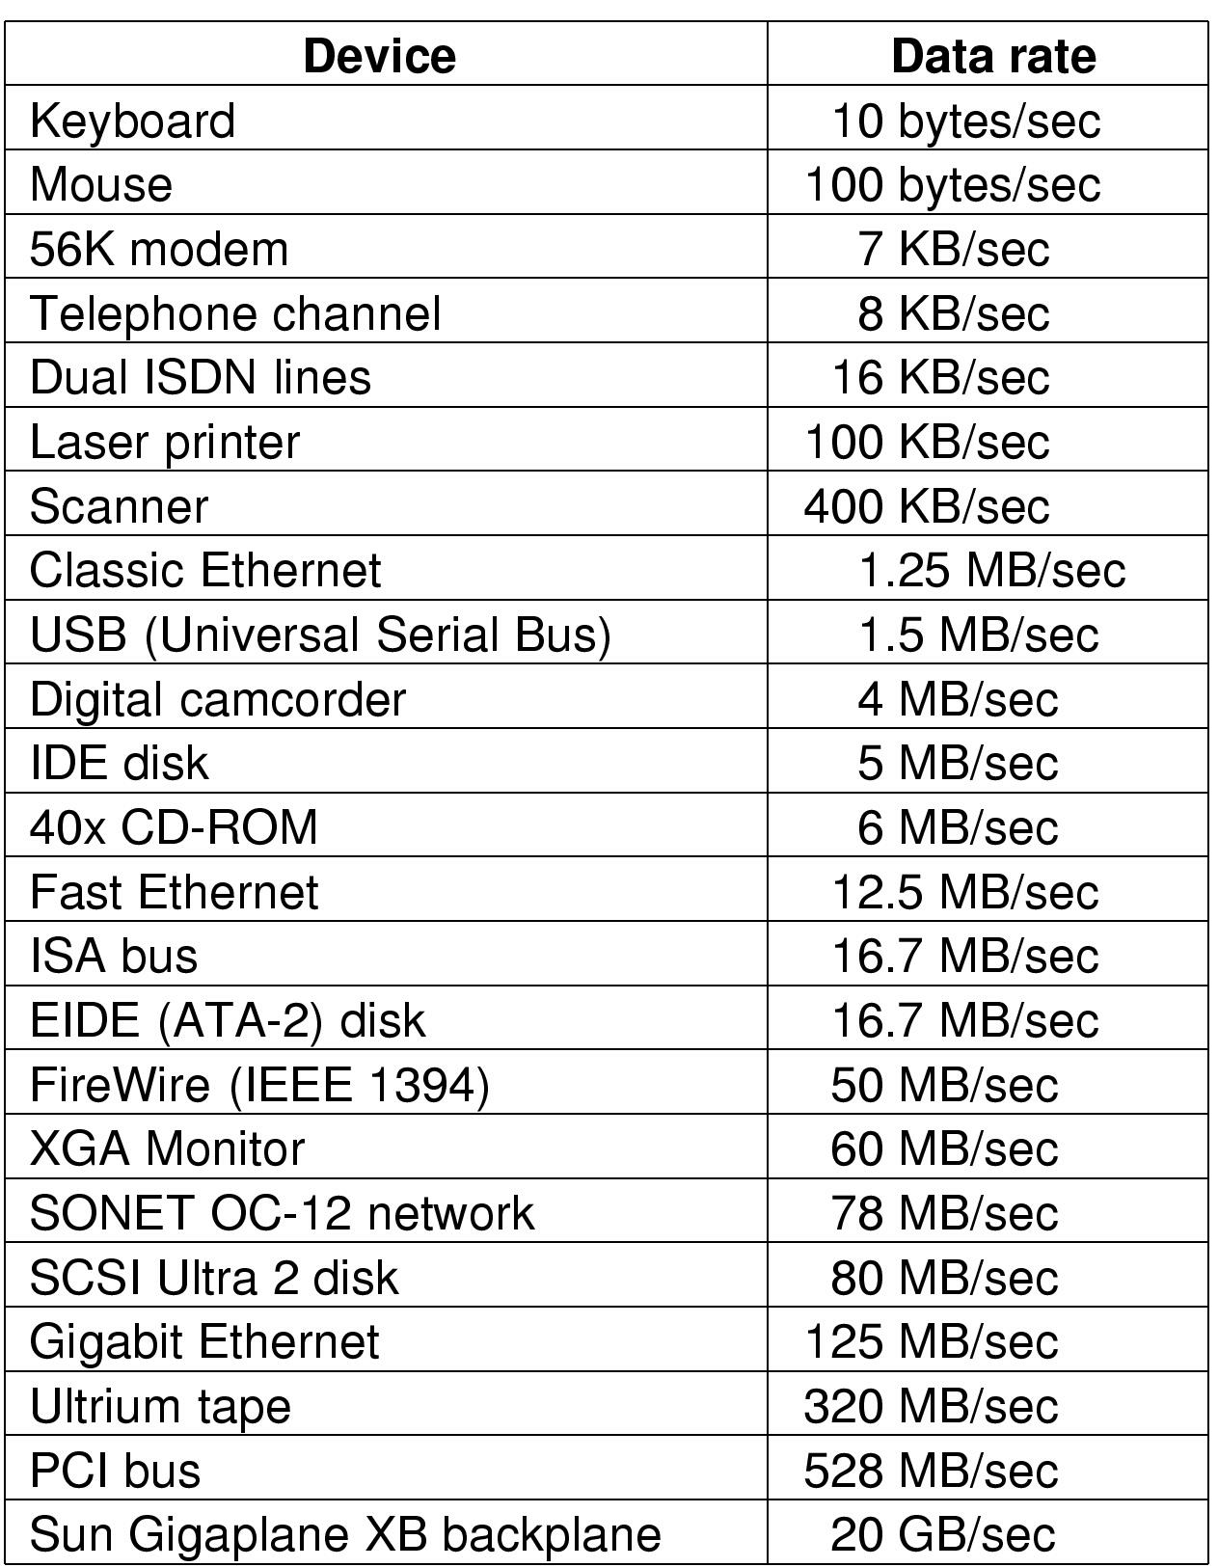
Wide range of I/O device speeds

Slide 9
Performance challenges: I/O hardware
How to prevent slow devices from slowing down memory due to bus contention
  What is bus contention?
How to access I/O addresses without interfering with memory performance

Slide 10
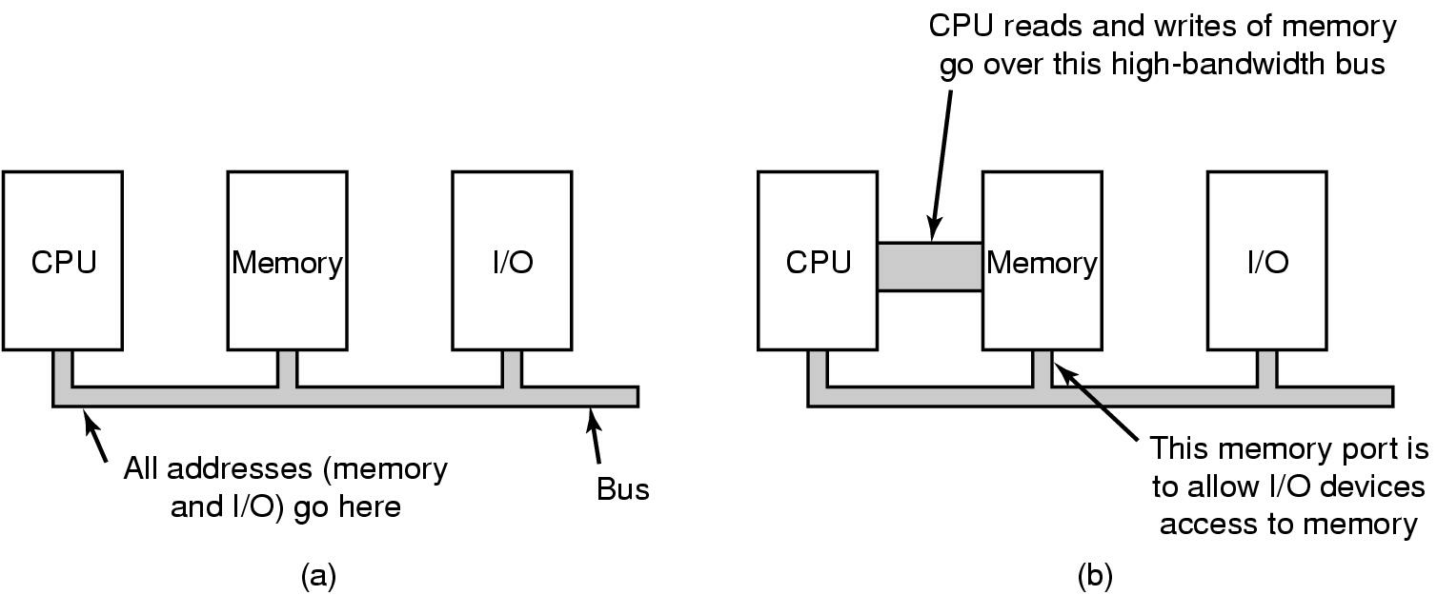
Single vs. dual bus architecture

Slide 11

Hardware view of Pentium
Structure of a large Pentium system

Slide 12
Performance challenges: I/O software
How to prevent CPU throughput from being limited by I/O device speed (for slow devices)
  Why would slow devices affect the CPU?
How to prevent I/O throughput from being limited by CPU speed (for fast devices)
  Why would device throughput be limited by the CPU?
How to achieve good utilization of CPU and I/O devices
How to meet the real-time requirements of devices

Slide 13
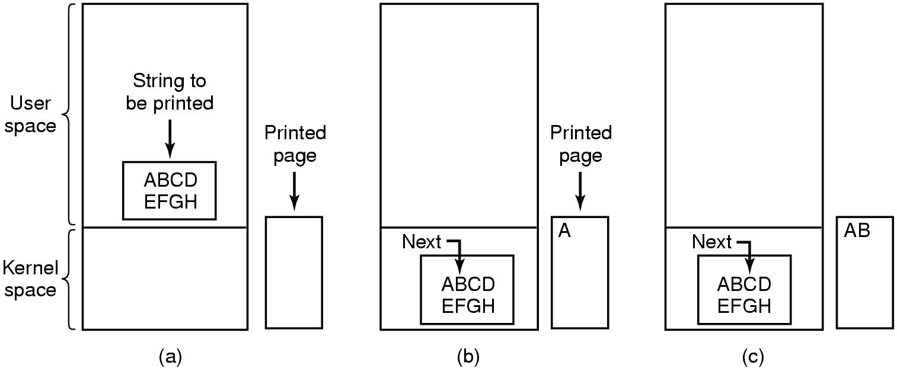
Programmed I/O
Steps in printing a string

Slide 14
Programmed I/O
Example:
  Writing a string to a serial output
  Printing a string on the printer
CopyFromUser(virtAddr, kernelBuffer, byteCount)
for i = 0 to byteCount-1
while *serialStatusReg != READY
endWhile
*serialDataReg = kernelBuffer[i]
endFor
return
Called “Busy Waiting” or “Polling”
Problem: CPU is continually busy working on I/O!

Slide 15
Interrupt-Driven I/O
Getting the I/O started:
CopyFromUser(virtAddr, kernelBuffer, byteCount)
EnableInterrupts()
while *serialStatusReg != READY
endWhile
*serialDataReg = kernelBuffer[0]
Sleep ()
The Interrupt Handler:
if i == byteCount
Wake up the user process
else
*serialDataReg = kernelBuffer[i]
i = i + 1
endIf
Return from interrupt

Slide 16

Hardware support for interrupts
How interrupts happen. Connections between devices and interrupt controller actually use interrupt lines on the bus rather than dedicated wires

Slide 17
Problem with Interrupt driven I/O
Problem:
  CPU is still involved in every data transfer
  Interrupt handling overhead is high
  Overhead cost is not amortized over much data
  Overhead is too high for fast devices
    Gbps networks
    Disk drives

Slide 18
Direct Memory Access (DMA)
Data transferred from device straight to/from memory
CPU not involved
The DMA controller:
  Does the work of moving the data
  CPU sets up the DMA controller (“programs it”)
  CPU continues
  The DMA controller moves the bytes

Slide 19
Sending data to a device using DMA
Getting the I/O started:
CopyFromUser(virtAddr, kernelBuffer, byteCount)
Set up DMA controller
Sleep ()
The Interrupt Handler:
Acknowledge interrupt
Wake up the user process
Return from interrupt

Slide 20

Direct Memory Access (DMA)

Slide 21
Direct Memory Access (DMA)
Cycle Stealing
  DMA Controller acquires control of bus
  Transfers a single byte (or word)
  Releases the bus
  The CPU is slowed down due to bus contention
Burst Mode
  DMA Controller acquires control of bus
  Transfers all the data
  Releases the bus
  The CPU operation is temporarily suspended

Slide 22
Direct Memory Access (DMA)
Cycle Stealing
  DMA controller acquires control of bus
  Transfers a single byte (or word)
  Releases the bus
  The CPU is slowed down due to bus contention
  Responsive but not very efficient
Burst Mode
  DMA Controller acquires control of bus
  Transfers all the data
  Releases the bus
  The CPU operation is suspended
  Efficient but interrupts may not be serviced in a timely way

Slide 23
Principles of I/O software
Device Independence
  Programs can access any I/O device
    Hard Drive, CD-ROM, Floppy,...
    ... without specifying the device in advance
Uniform Naming
  Devices / Files are named with simple strings
  Names should not depend on the device
Error Handling
  ...should be as close to the hardware as possible
  … because its often device-specific

Slide 24
Principles of I/O software
Synchronous vs. Asynchronous Transfers
  Process is blocked vs. interrupt-driven or polling approaches
Buffering
  Data comes off a device
  May not know the final destination of the data
    e.g., a network packet... Where to put it???
Sharable vs. Dedicated Devices
  Disk should be sharable
  Keyboard, Screen dedicated to one process

Slide 25
Software engineering-related challenges
How to remove the complexities of I/O handling from application programs
  Solution
    standard I/O APIs (libraries and system calls)
How to support a wide range of device types on a wide range of operating systems
  Solution
    standard interfaces for device drivers (DDI)
    standard/published interfaces for access to kernel facilities (DKI)

Slide 26
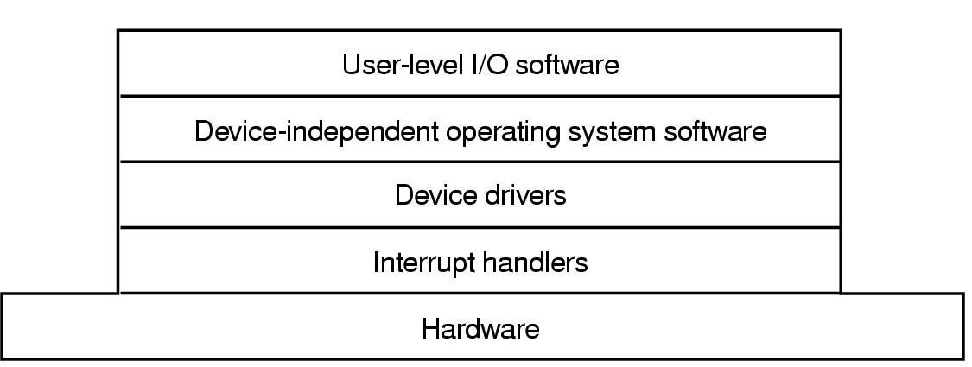
I/O software layers

Slide 27
I/O software layers

Slide 28
Interrupt handling
I/O Device Driver starts the operation
  Then blocks until an interrupt occurs
  Then it wakes up, finishes, & returns
The Interrupt Handler
  Does whatever is immediately necessary
  Then unblocks the driver
Example: The BLITZ “DiskDriver”
  Start I/O and block (waits on semaphore)
  Interrupt routine signals the semaphore & returns

Slide 29
Interrupt handlers – top/bottom halves
Interrupt handlers are divided into scheduled and non scheduled tasks
Non-scheduled tasks execute immediately on interrupt and run in the context of the interrupted thread
  Ie. There is no VM context switch
  They should do a minimum amount of work so as not to disrupt progress of interrupted thread
  They should minimize time during which interrupts are disabled
Scheduled tasks are queued for processing by a designated thread
  This thread will be scheduled to run later
  May be scheduled preemptively or nonpreemptively

Slide 30
Basic activities of an interrupt handler
  Set up stack for interrupt service procedure
  Ack interrupt controller, reenable interrupts
  Copy registers from where saved
  Run service procedure

Slide 31
I/O software layers

Slide 32
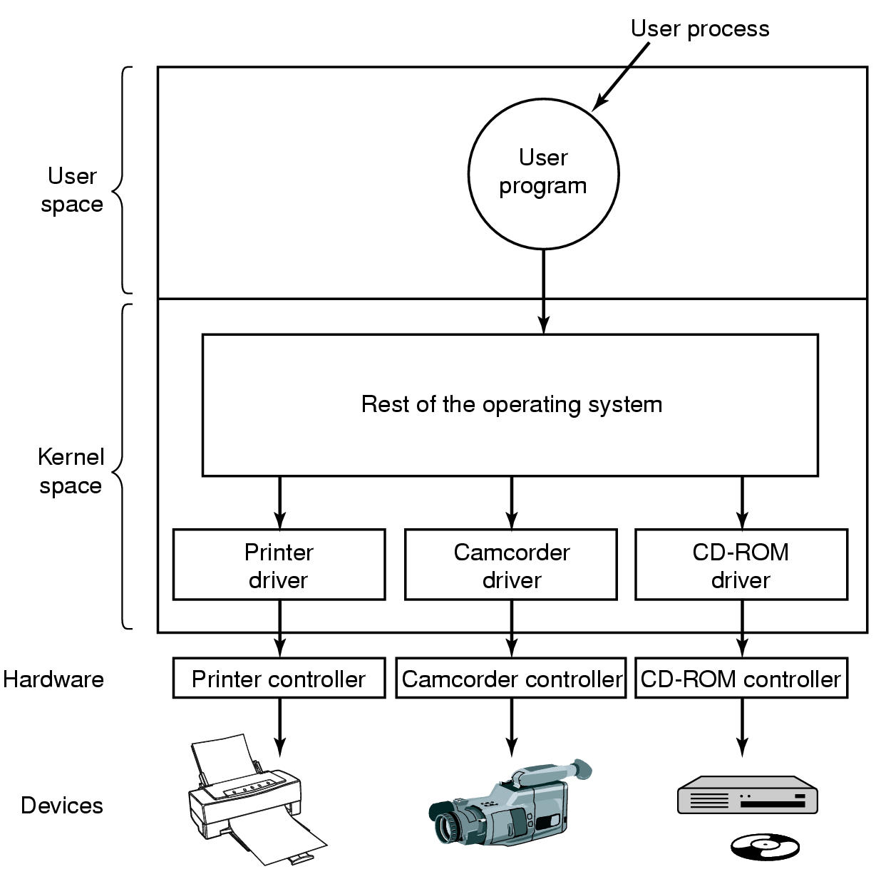
Device drivers in kernel space

Slide 33
Device drivers
Device drivers are device-specific software that connects devices with the operating system
  Typically a nasty assembly-level job
    Must deal with hardware-specific details (and changes)
    Must deal with O.S. specific details (and changes)
  Goal: hide as many device-specific details as possible from higher level software
Device drivers are typically given kernel privileges for efficiency
  Bugs can bring down the O.S.!
  Open challenge: how to provide efficiency and safety???

Slide 34
I/O software layers

Slide 35
Device-independent I/O software
Functions and responsibilities
  Uniform interfacing for device drivers
  Buffering
  Error reporting
  Allocating and releasing dedicated devices
  Providing a device-independent block size

Slide 36
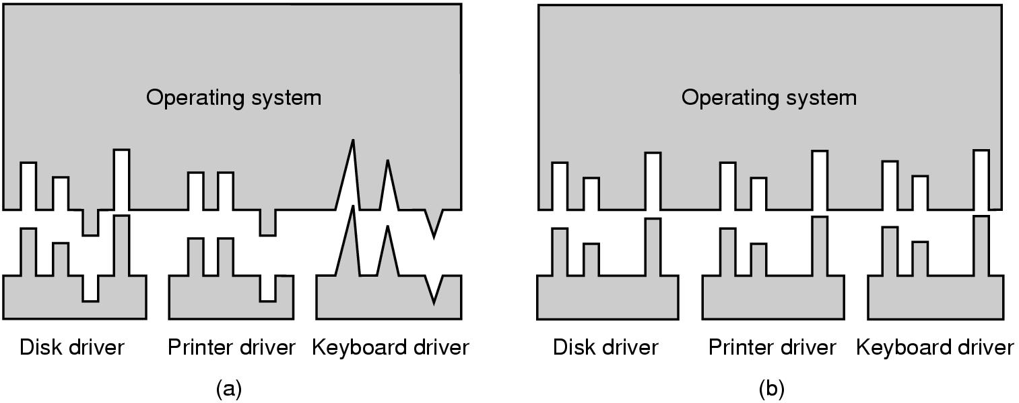
Device-independent I/O software
Device Driver Interface (DDI) and Device Kernel Interface (DKI)
without/with standardization

Slide 37
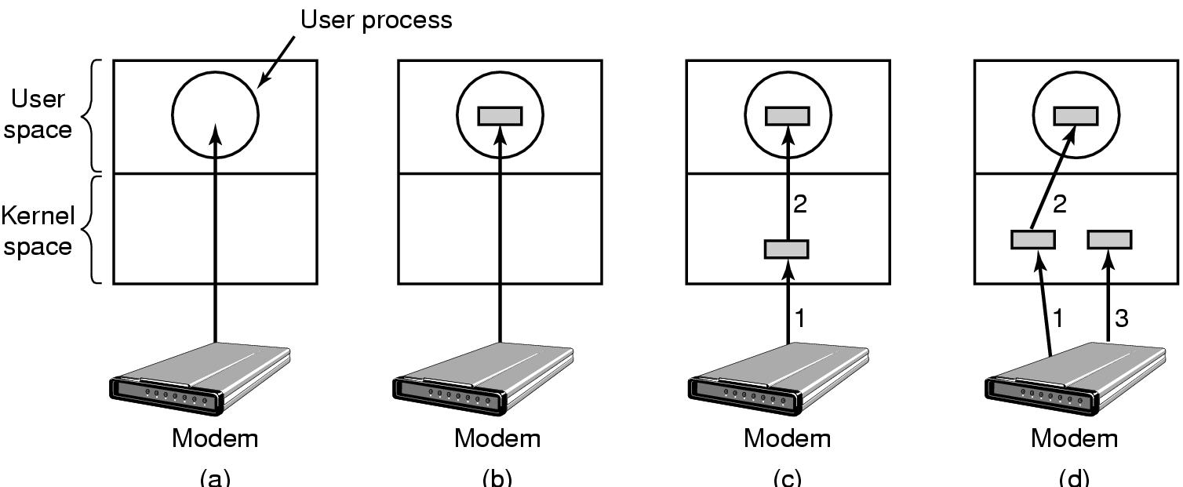
Device-independent I/O software buffering
(a) Unbuffered input
(b) Buffering in user space
(c) Buffering in the kernel followed by copying to user space
(d) Double buffering in the kernel

Slide 38
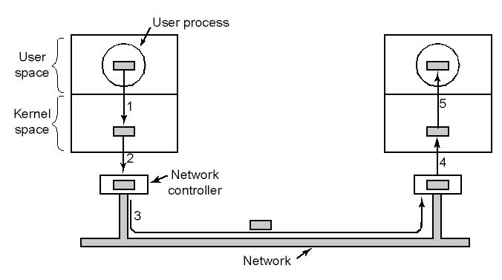
Copying overhead in network I/O
Networking may involve many copies

Slide 39
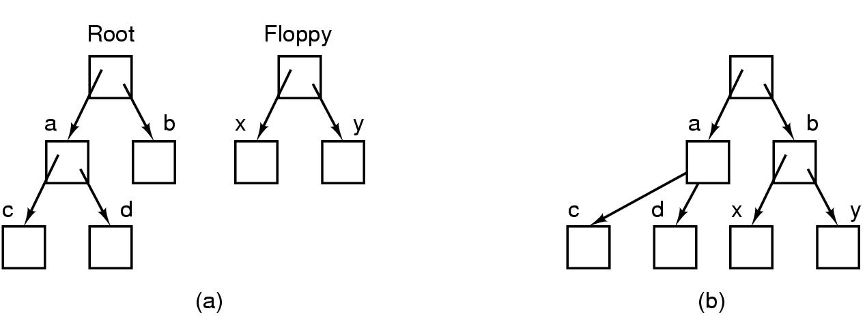
Devices as files
Before mounting,
  files on floppy are inaccessible
After mounting floppy on b,
  files on floppy are part of file hierarchy

Slide 40
I/O software layers

Slide 41
User-space I/O software
In user’s (C) program
count = write (fd, buffer, nbytes);
printf (“The value of %s is %d\n”, str, i);
Linked with library routines.
The library routines contain:
  Lots of code
  Buffering
  The syscall to trap into the kernel

Slide 42
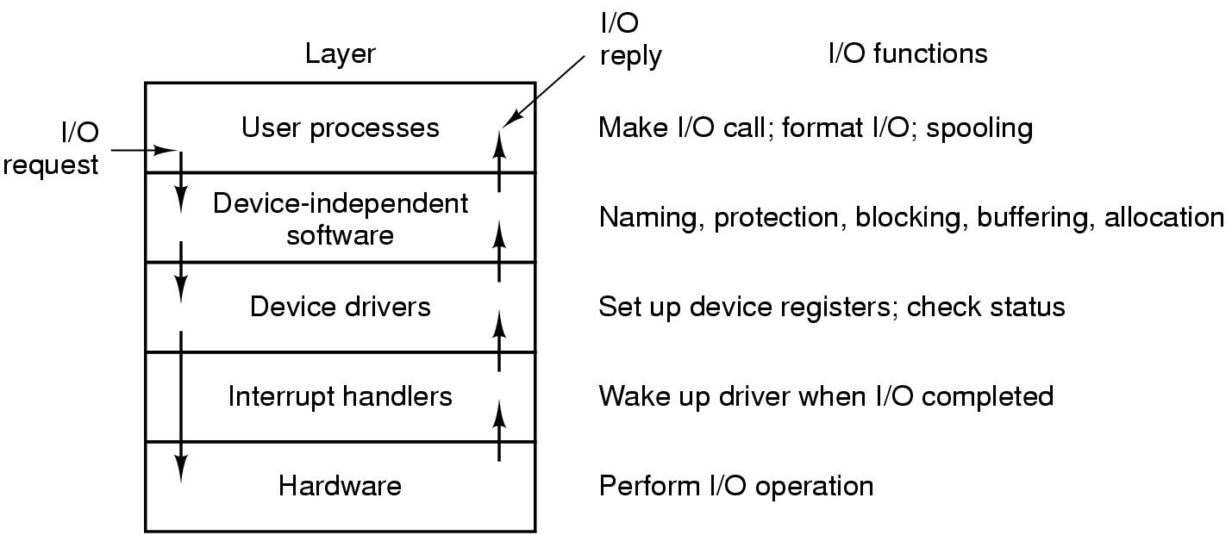
Communicating across the I/O layers

Slide 43
Some example I/O devices
Timers
Terminals
Graphical user interfaces
Network terminals

Slide 44
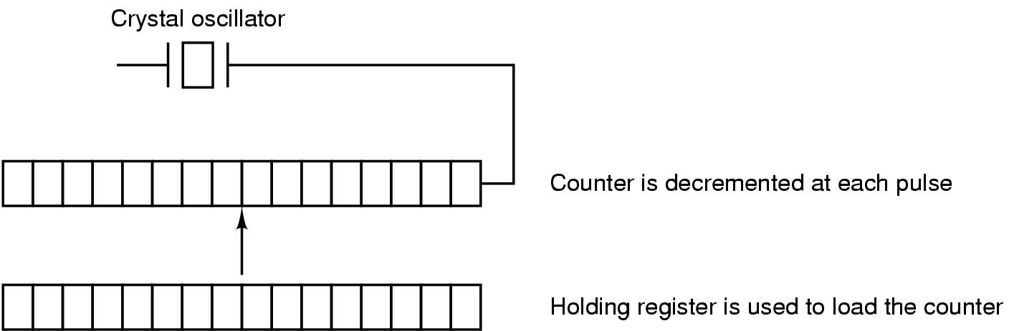
Programmable clocks
One-shot mode:
  Counter initialized then decremented until zero
  At zero a single interrupt occurs
Square wave mode:
  At zero the counter is reinitialized with the same value
  Periodic interrupts (called “clock ticks”) occur

Slide 45
Time
500 MHz Crystal (oscillates every 2 nanoseconds)
32 bit register overflows in 8.6 seconds
  So how can we remember what the time is?
Backup clock
  Similar to digital watch
  Low-power circuitry, battery-powered
  Periodically reset from the internet
  UTC: Universal Coordinated Time
  Unix: Seconds since Jan. 1, 1970
  Windows: Seconds since Jan. 1, 1980

Slide 46
Goals of clock software
Maintain time of day
  Must update the time-of-day every tick
Prevent processes from running too long
Account for CPU usage
  Separate timer for every process
  Charge each tick to the current process
Handling the “Alarm” syscall
  User programs ask to be sent a signal at a given time
Providing watchdog timers for the OS itself
  E.g., when to spin down the disk
Doing profiling, monitoring, and statistics gathering

Slide 47
Software timers
A process can ask for notification (alarm) at time T
  At time T, the OS will signal the process
Processes can “go to sleep until time T”
Several processes can have active timers
The CPU has only one clock
  Must service the “alarms” in the right order
Keep a sorted list of all timers
  Each entry tells when the alarm goes off and what to do then

Slide 48
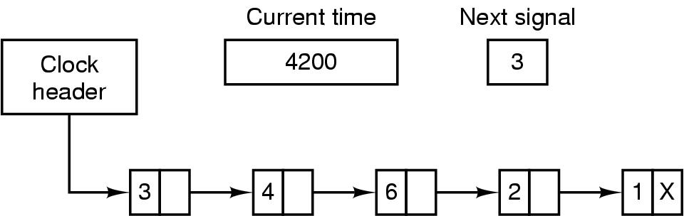
Software timers
Alarms set for 4203, 4207, 4213, 4215 and 4216.
Each entry tells how many ticks past the previous entry.
On each tick, decrement the “NextSignal”.
When it gets to 0, then signal the process.

Slide 49
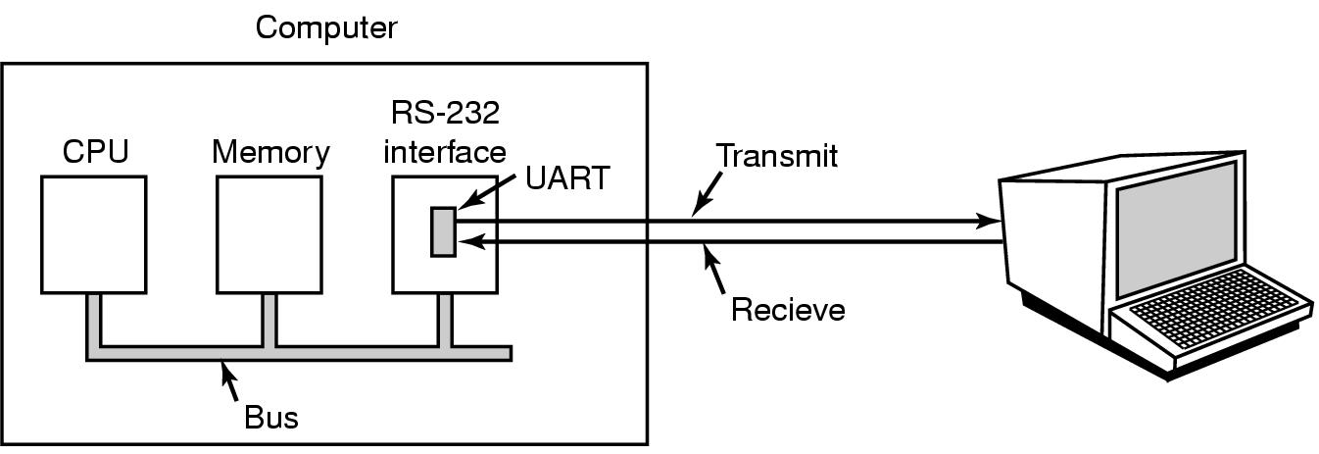
Character-oriented I/O
RS-232 / Serial interface / Modem / Terminals / tty / COM
Bit serial (9- or 25-pin connectors), only 3 wires used
UART: Universal Asynchronous Receiver Transmitter
  byte → serialize bits → wire → collect bits → byte

Slide 50
Terminals
56,000 baud = 56,000 bits per second = 7000 bytes / sec
  Each is an ASCII character code
Dumb terminals (CRTs / teletypes )
  Very few control characters
    newline, return, backspace
Intelligent CRTs
  Also accept “escape sequences”
  Reposition the cursor, clear the screen, insert lines, etc.
  The standard “terminal interface” for computers
    Example programs: vi, emacs

Slide 51
Input software
Character processing
  User types “hella←o”
  Computer echoes as: “hella←_←o”
  Program will see “hello”
Raw mode
  The driver delivers all characters to application
  No modifications, no echoes
  vi, emacs, the BLITZ emulator, password entry
Cooked mode
  The driver does echoing and processing of special chars.
  “Canonical mode”

Slide 52
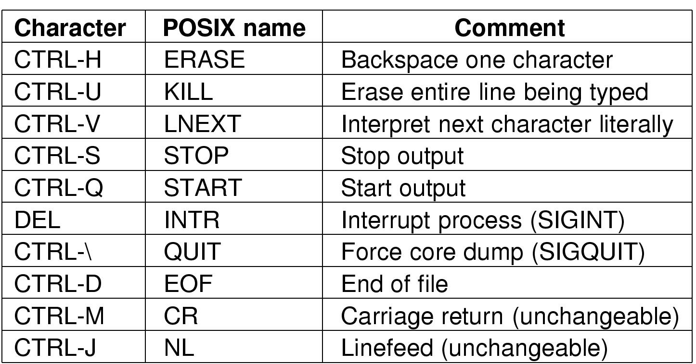
Special control characters (in “cooked mode”)

Slide 53
Cooked mode
The terminal driver must...
  Buffer an entire line before returning to application
  Process special control characters
    Control-C, Backspace, line-erase, tabs
  Echo the character just typed
  Accommodate type-ahead
    Ie., it needs an internal buffer
Approach 1 (for computers with many terminals)
  Have a pool of buffers to use as necessary
Approach 2 (for single-user computer)
  Have one buffer (e.g., 500 bytes) per terminal

Slide 54
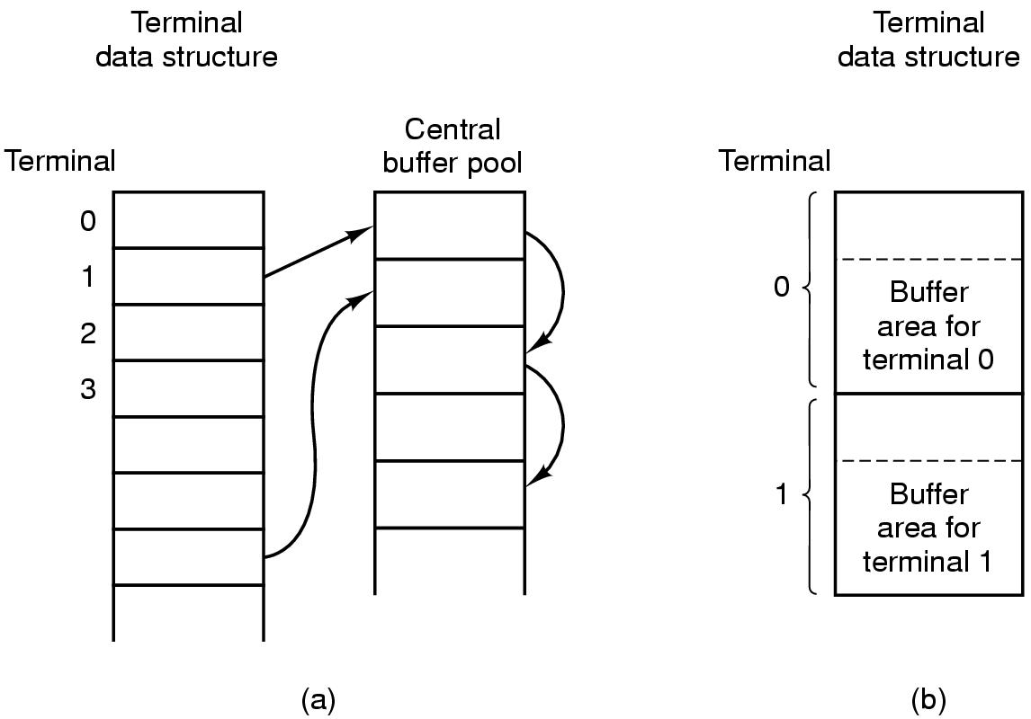
Central buffer pool vs. dedicated buffers

Slide 55
The end-of-line problem
NL “newline” (ASCII 0x0A, \n)
  Move cursor down one line (no horizontal movement)
CR “return” (ASCII 0x0D, \r)
  Move cursor to column 1 (no vertical movement)
“ENTER key”
  Behavior depends on the terminal specs
    May send CR, may send NL, may send both
    Software must be device independent
Unix, Macintosh:
  Each line (in a file) ends with a NL
Windows:
  Each line (in a file) ends with CR & NL

Slide 56
Control-D: EOF
Typing Control-D (“End of file”) causes the read request to be satisfied immediately
  Do not wait for “enter key”
  Do not wait for any characters at all
  May return 0 characters
Within the user program
count = Read (fd, buffer, buffSize)
if count == 0
-- Assume end-of-file reached...

Slide 57
Outputting to a terminal
The terminal accepts an “escape sequence”
Tells it to do something special
Example:
esc [ 3 ; 1 H esc [ 0 K esc [ 1 M
Each terminal manufacturer had a slightly different specification
  Makes device independent software difficult
  Unix “termcap” file
    Database of different terminals and their behaviors.
ESCAPE:
0x1B
Move to
position (3,1)
on screen
Erase
the line
Shift
following
lines up one

Slide 58
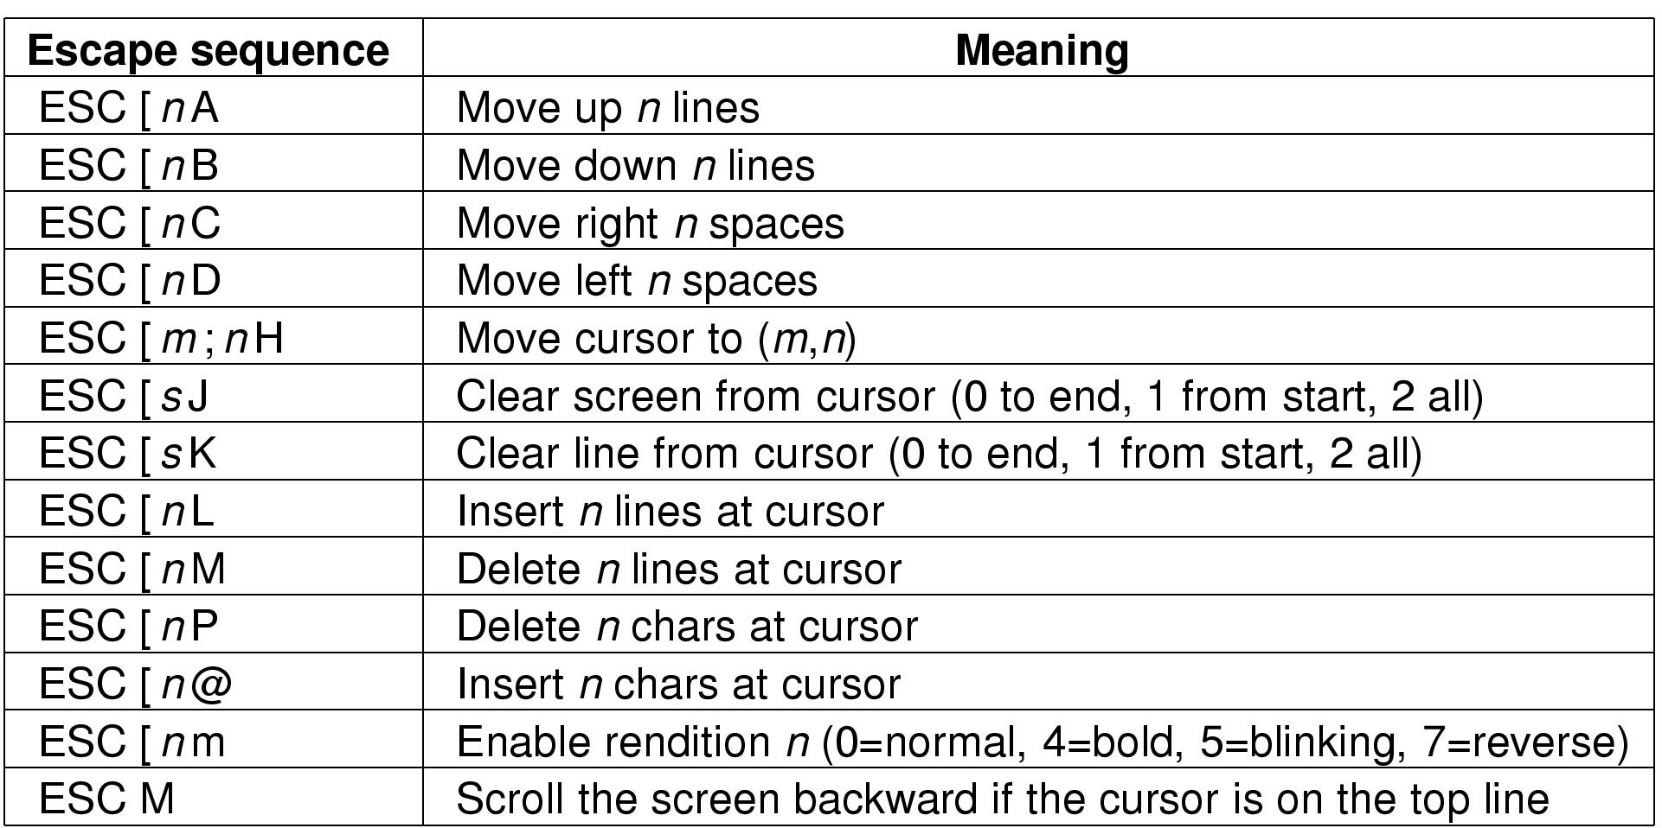
ANSI escape sequence standard

Slide 59
Graphical user interfaces (GUIs)
Memory-mapped displays “bit-mapped graphics”
Video driver moves bits into special memory region
  Changes appear on the screen
  Video controller constantly scans video ram
Black and white displays
  1 bit = 1 pixel
Color
  24 bits = 3 bytes = 1 pixels
    red (0-255)
    green (0-255)
    blue (0-255)
1280 * 854 * 3
= 3 MB

Slide 60
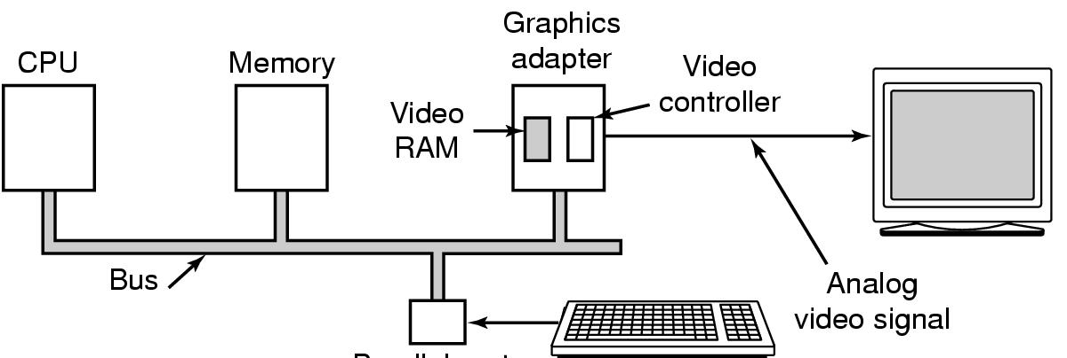
Graphical user interfaces (GUIs)

Slide 61
Spare slides

Slide 62
X Window System
Client - Server
Remote Procedure Calls (RPC)
Client makes a call.
Server is awakened; the procedure is executed.
Intelligent terminals (“X terminals”)
The display side is the server.
The application side is the client.
The application (client) makes requests to the display server.
Client and server are separate processes
  (May be on the same or different machines)

Slide 63
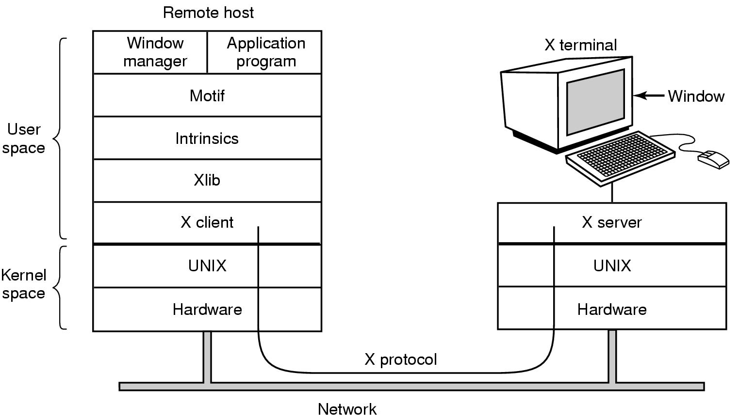
X window system

Slide 64
X window system
X-Server
  Display text and geometric shapes, move bits
  Collect mouse and keyboard status
X-Client
  Xlib
    library procedures; low-level access to X-Server
  Intrinsics
    provide “widgets”
    buttons, scroll bars, frames, menus, etc.
  Motif
    provide a “look-and-feel” / style
  Window Manager
    Application independent functionality
    Create & move windows

Slide 65
The SLIM network terminal
Stateless Low-level Interface Machine (SLIM)
  Sun Microsystems
Philosophy: Keep the terminal-side very simple!
Back to “dumb” terminals”
Interface to X-Server:
  100’s of functions
SLIM:
  Just a few messages
  The host tells which pixels to put where
  The host contains all the intelligence

Slide 66
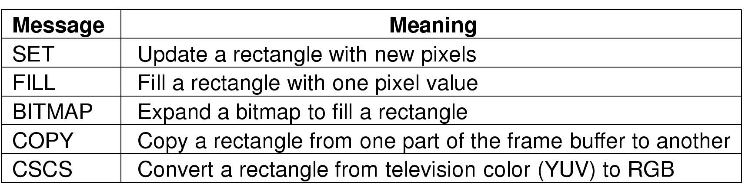
The SLIM network terminal
The SLIM Protocol
  from application-side (server)
  to terminal (the “thin” client)

